Slide 1
Foundations of Crystallography Third Edition
Python Installation Instructions

Slide 2
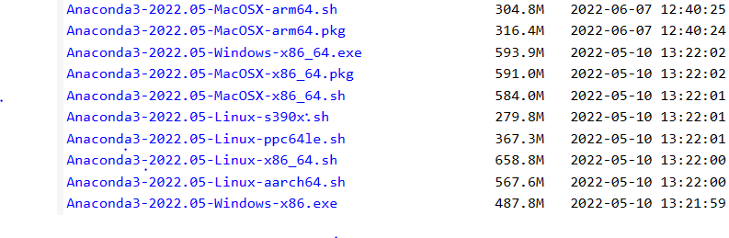
Download Anaconda3-2022.05
Anaconda is a collection of Python and key data science libraries.
As Anaconda is constantly evolving, please use the version that this software was tested.
Use your search engine to find “anaconda archive downloads”. Currently this is https://repo.anaconda.com/archive/
Pick based on your operating system. Likely choice: Anaconda3-2022.05-Windows-x86_64

Slide 3
Make sure you have 2.7 GB of disk space Install the executable

Slide 4
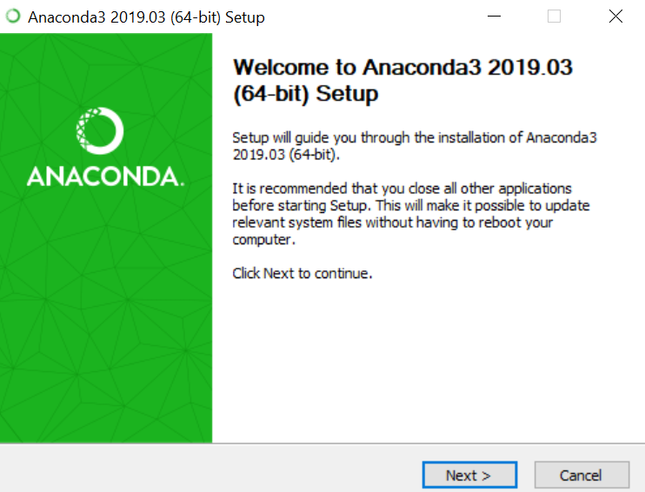
Then run the installer. Accept all defaults and press Next on each screen.

Slide 5
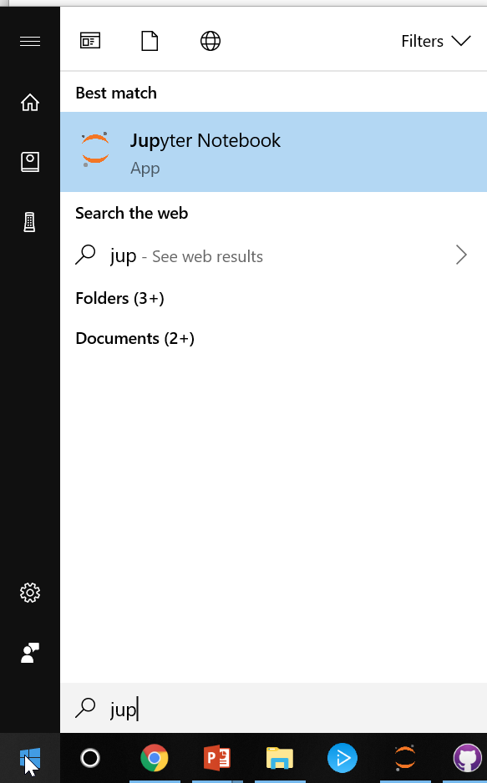
1) Then restart your machine and 2) Close all browsers (Chrome, IE, Firefox, etc.) 2) Open Jupyter Notebook

Slide 6
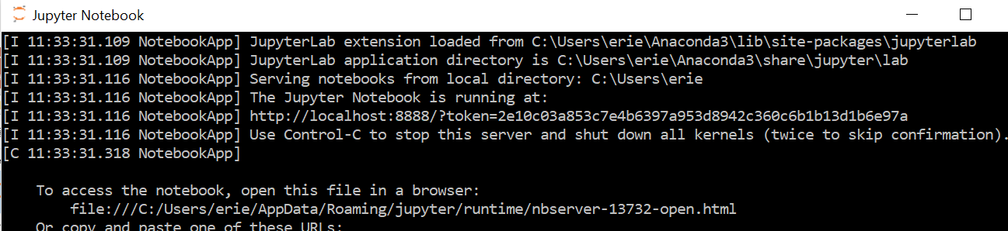
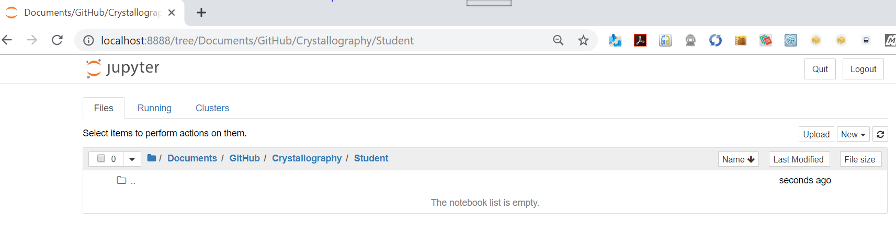
Jupyter Notebooks opens two programs 1) A web server that runs on your machine 2) A web client that opens in your default browser
Jupyter web server – leave running in the background
Only one web server should be open at a time
Jupyter web client – appears as a new tab in your default browser

Slide 7
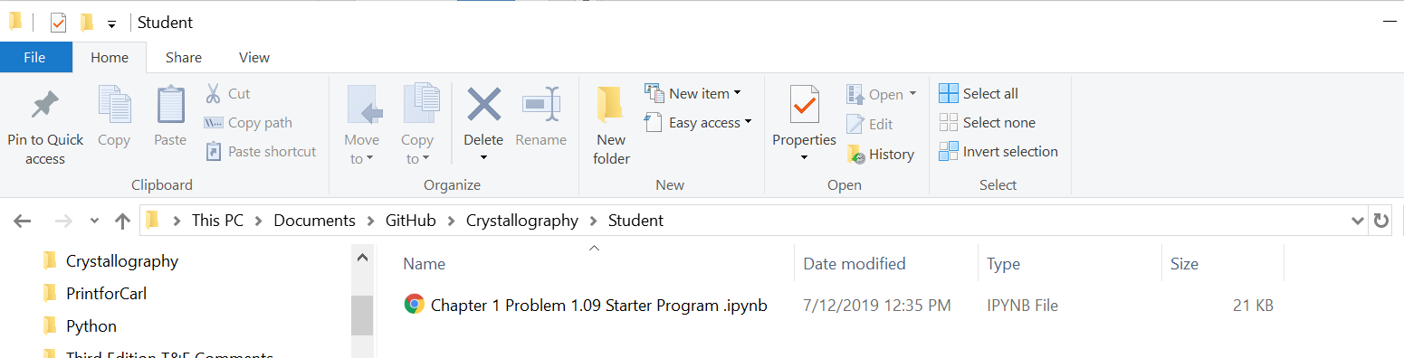
Save your first starter program from Canvass (Problem 1.9) to a directory and open in Jupyter
Save the starter program to a convenient directory (ex: Documents/Crystal)
Navigate to that directory (Documents/Crystal) in the web client of Juypter (that should be open in your browser)

Slide 8
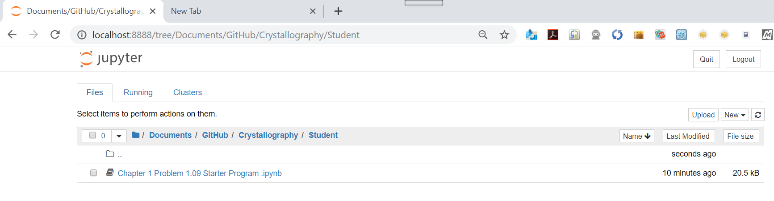
Now when you refresh your browser, double click on the starter program within Jupyter client
Symbol of main Jupyter tab
Double click here to open a new tab for Starter Program

Slide 9
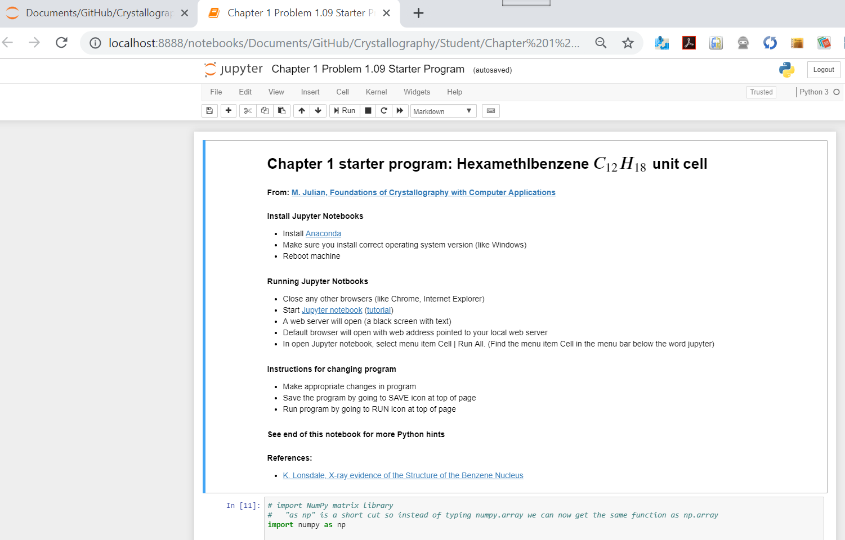
Starter program tab
Main Jupyter tab -- only 1 should be open
Next step: Cell | Run all
Start programming here

